Slide 1
Bank Classification
Yena Lee

Slide 2
Summary of Data
Call campaign data from a Portugese bank
41,188 observations with 21 variables
Demographic data of a client, e.g. age & job title
Touchpoint of current & the previous campaigns
Campaign results
11% of clients subscribed to the term deposit

Slide 3
Sanity Checking
Age >=18 and < 150
# contacts for the current campaign >= 1
If the client subscribed to term deposit, then the last contact duration >0

Slide 4
Sanity Checking, Cont’d
If a client was not contacted by the previous campaign, then the # of contacts from the previous campaign should be 0
If ‘pdays’ == 999, then ’previous’ == 0
Observation: 4,110 records violates the rule
Treatment: Replace the 4,110 records of the # of contacts from the previous campaign with 0

Slide 5
Sanity Checking, Cont’d
If a client was not contacted by the previous campaign, then the outcome of the previous campaign should be nonexistent
If ‘pdays’ == 999, then ’poutcome’ == ‘nonexistent’
Observation: 4,110 records violates the rule
Treatment: Replace the 4,110 records of the the outcome from the previous campaign with nonexistent records
After sanity checking, the erroneous records, 10% of 41,188 observations were fixed with 96% of the clients were not contacted by the previous campaign

Slide 6
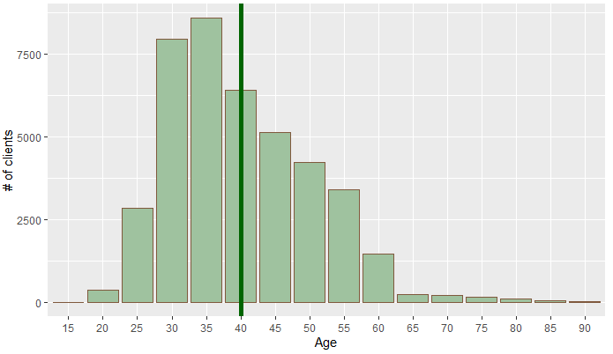
Age
Majority of the targeted clients, or 22% are between 30-35, while < 2% of the clients are > 65
Average age of the clients is 40

Slide 7
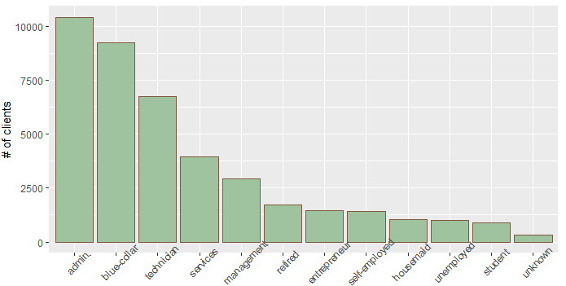
Job
Majority, 25% of job titles are admin, followed by blue-collar and technician
Only 2% of the clients are student
Unknown job title is <1%

Slide 8
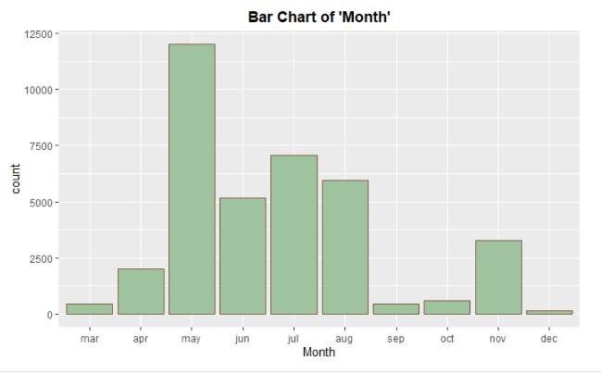
Month
Majority, or 33% of the last contacts were performed in May, followed by Jun, July, and Aug
Least, <1% of contacts were performed in Dec
No contact was performed on Jan and Feb

Slide 9
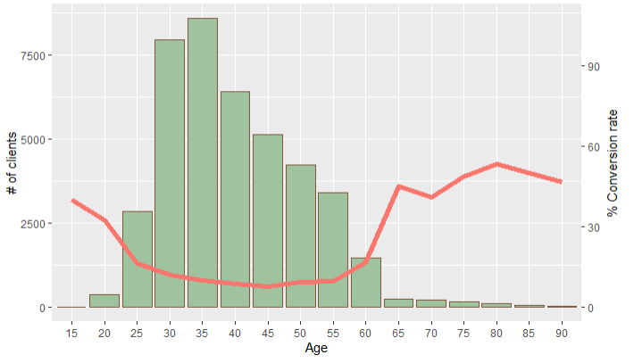
Age Vs Conversion Rate
For clients with age <55, the conversion rate decreases as age increases, whereas the conversion rate increases as age increases for clients with age>55
Majority, or 22% of the targeted clients with age between 30-35 exhibited almost the lowest conversion rate, 10%
The highest conversion rate, 50%, happens when clients are >65, however, they are only 2% of the whole clients
Clients with age <25 exhibited >20% of conversion rate, which is relatively high; however, they are only 4% of the clients

Slide 10
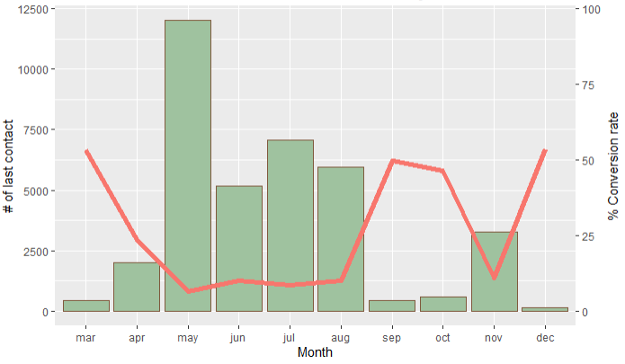
Month Vs Conversion Rate
The conversion rate decreases on months, May, when # of contacts increase; however, the conversion rates increase on months, Sep, when # of contacts decreases
The lowest conversion rate, 6%, happens in May when the majority, or 33% of the clients were contacted
On the other hand, the highest conversion rate, 50%, happens on Mar and Dec when the least clients were contacted, <2% of the contacts
Notes:
The conversion rate was 50% at the beginning of the year, but it drops to 6% just in 2 months
Until Aug, the conversion rate stays around the low rates, < 10%
Starting from Sep, the conversion rate gets increased to 50% again only except for Nov
The conversion rates are significantly low on 5 months when 90% of calls were performed

Slide 11
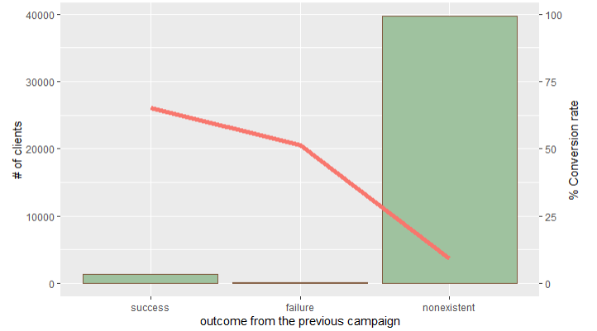
Previous vs Current Campaign Outcome
Whether or not the client was contacted from the previous campaign is likely to impact on the outcome of the current campaign
Clients who said yes to the previous campaign exhibited a conversion rate of 65%, and even clients who said no exhibited 50% of conversion rate; however newly contacted clients, 95% of our targeted clients, exhibited much lower conversion rate <10%
However, only <4% clients were contacted from the previous campaign
Notes:
Customers who were contacted for the previous campaign are more likely to respond ‘yes’ to the current customers compared to customers who were not contacted before. So phone call campaign can be used as a mean of investment for future campaigns.
Previous contacted customers are more likely to respond “yes” to a current campaign compared to newly contacted customers.
Even customers who previously said “no” are more likely to respond “yes” compared to newly contacted customers. there are xx records that...

